Slide 1
PowerPoint is Awesome

Slide 2


Slide 3
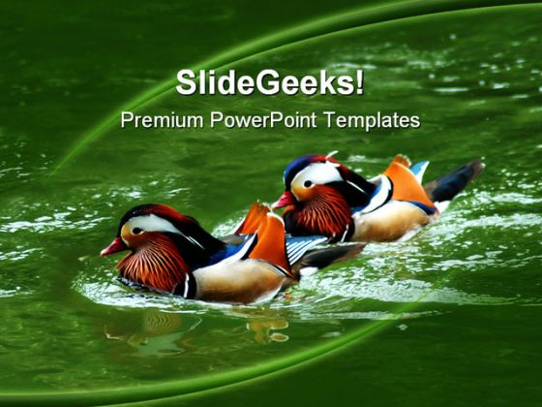

Slide 4
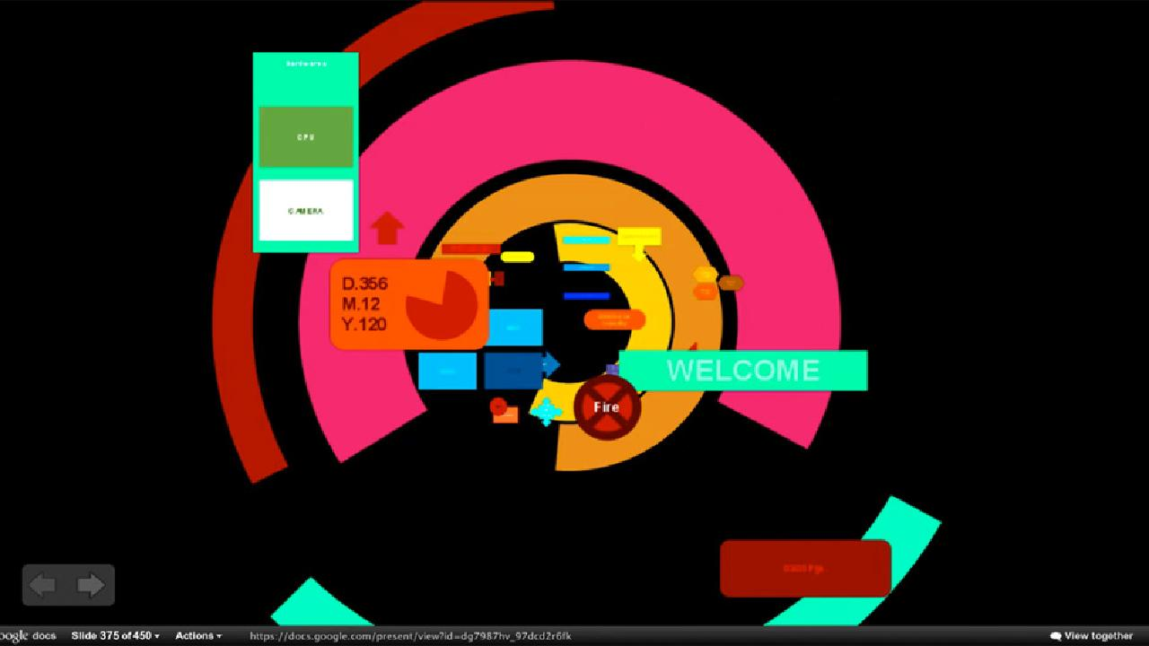

Slide 5
